Slide 1
Trees & Tree Traversals
CSE 2215 - Lecture 10 – Summer 2023
Instructor : Fahmid Al Rifat, Lecturer, Dept. of CSE , UIU

Slide 2

What is a Tree?
A connected acyclic graph is a tree
In computer science, a tree is an abstract model
of a hierarchical structure
A tree consists of nodes with
a parent-child relationship
Applications:
Organizational charts
File systems
Programming environments

Slide 3
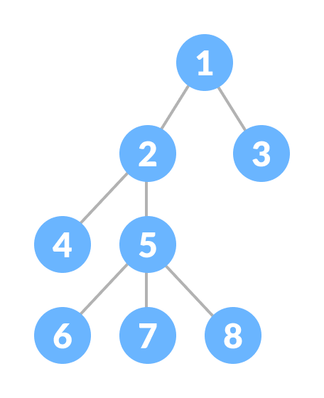
What is a Tree?
A connected acyclic graph is a tree.
A tree T is a set of nodes in a parent-child
relationship with the following properties:
T has a special node r, called the root of T, with no parent node
Each node v of T, different from r, has a unique parent node u

Slide 4

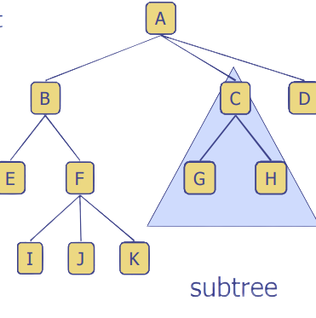
Tree Terminology
Root: node without parent (A)
Internal node: node with at least one child (A, B, C, F)
External node (Leaf ): node without children (E, I, J, K, G, H, D)
Ancestors of a node: parent, grandparent, grand-grandparent, etc.
Descendants of a node: child, grandchild, grand-grandchild, etc.
Subtree: tree consisting of a node and its descendants

Slide 5
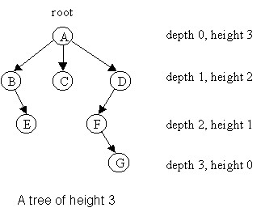
Depth
The depth of a node v can be recursively defined as follows
If v is the root, then the depth of v is 0.
Otherwise, the depth of v is one plus the depth of the parent of v
Algorithm
depth(T, v)
if T.isRoot(v) then
return 0
else
return 1 + depth(T, T.parent(v))
Running time: O(1 + d_{v}), d_{v} is depth of v in T
In worst case O(n), n is the number of nodes in T

Slide 6
Height
The height of a node v can be recursively defined as follows
If v is a leaf node, then the height of v is 0.
Otherwise, the height of v is one plus the maximum height of a child of v
The height of a tree T is the height of the root of T
The height of a tree T is equal to the maximum depth of a leaf node of T

Slide 7
Height
Algorithm height(T, v)
if T.isLeaf(v) then return 0
else
h = 0
for each w εT.children(v) do
h = max(h, height(T, w))
return 1 + h
Running time: O(Σ_{v ε T} (1 + c_{v})), where c_{v} is the number of children of v in T
Since Σ_{v ε T} c_{v =} n - 1, we have O(Σ_{v ε T} (1 + c_{v})) = O(n).
The height of tree T is obtained by calling height(T, r).

Slide 8
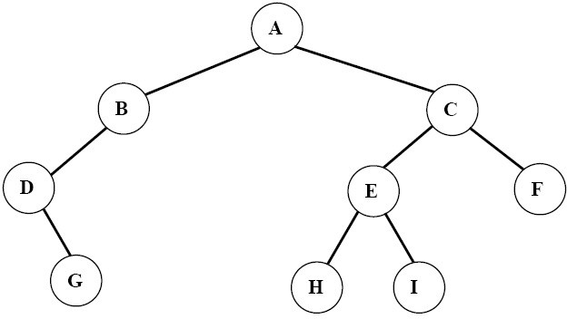
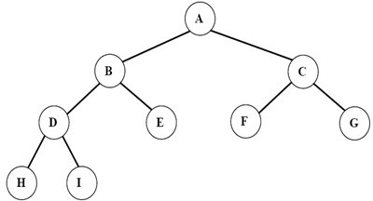
Ordered Trees
A tree is ordered if there is a linear ordering defined for each child of each node.
A binary tree is an ordered tree in which every node has at most two children.
If each node of a tree has either zero or two children, the tree is called a proper binary tree.
Binary Tree
Proper Binary Tree

Slide 9
Traversal of Trees
A traversal of a tree T is a systematic way of visiting all the nodes of T
Traversing a tree involves visiting the root and traversing its subtrees
There are the following traversal methods:
Preorder Traversal
Postorder Traversal
Inorder Traversal (of a binary tree)

Slide 10
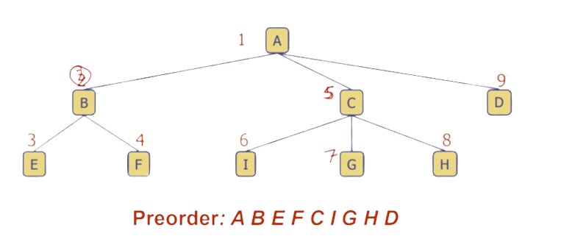
Preorder Traversal (General Tree)
In a preorder traversal, a node is visited before its descendants
If a tree is ordered, then the subtrees are traversed according to the order of the children

Slide 11
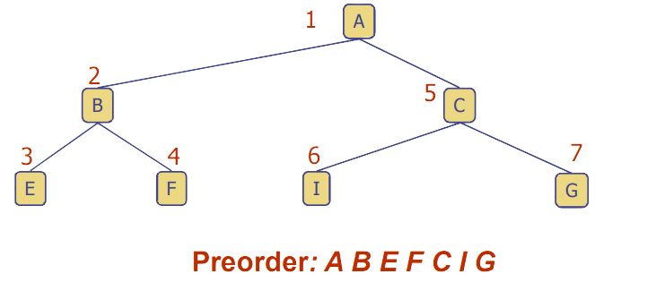
Preorder Traversal (Binary Tree)
Traversing a binary tree in Preorder
Visit the root.
Traverse the left subtree in Preorder.
Traverse the right subtree in Preorder.

Slide 12
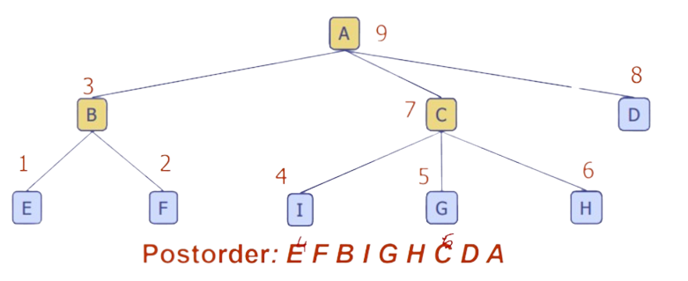
Postorder Traversal (General Tree)
In a postorder traversal, a node is visited after its descendants

Slide 13
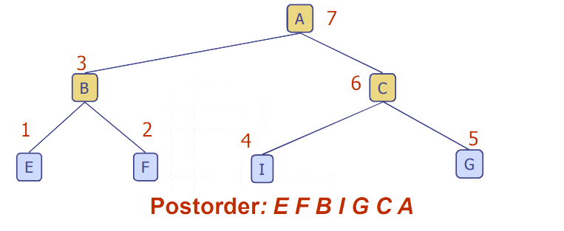
Postorder Traversal (Binary Tree)
Traversing a binary tree in Postorder
Traverse the left subtree in Preorder.
Traverse the right subtree in Preorder.
Visit the root.

Slide 14
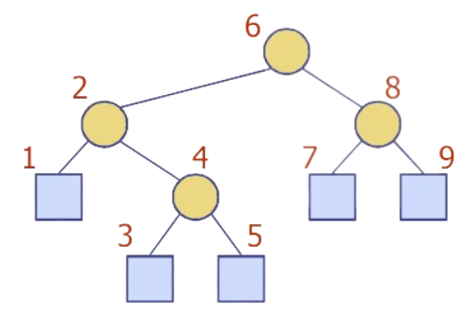
Inorder Traversal
In a postorder traversal, a node is visited after its descendants

Slide 15
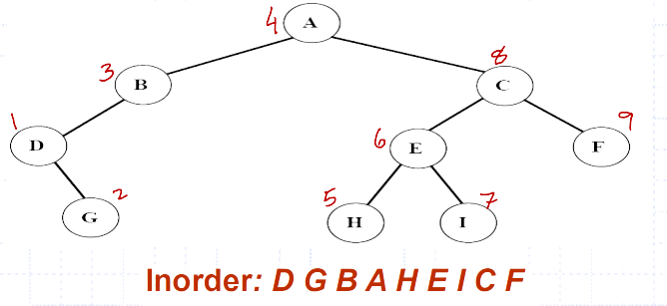
Inorder Traversal
Traversing a binary tree in inorder
Traverse the left subtree in inorder.
Visit the root.
Traverse the right subtree in inorder.

Slide 16
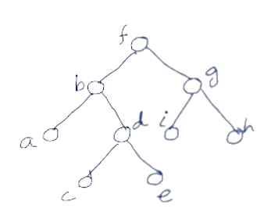

Preorder, Inorder, Postorder Traversals: Example

Slide 17
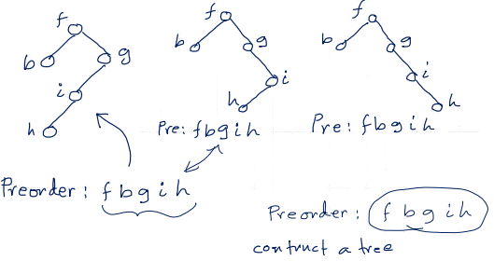
Construct a Binary Tree only from Preorder, Inorder or Postorder
Preoder: f →b →g →i →h
No Unique Tree if only one sequence is specified.
Need at least two traversal sequences to construct a unique tree.

Slide 18
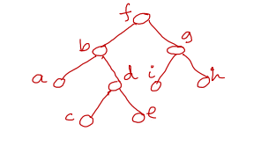
Construct a Binary Tree from Preorder & Inorder
Preoder: f → b → a → d → c → e → g → i → h
Inorder: a → b → c → d → e → f → i → g → h

Slide 19
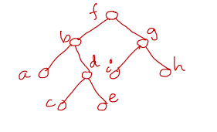
Construct a Binary Tree from Postorder & Inorder
Postoder: a → c → e → d → b → i → h → g → f
Inorder: a → b → c → d → e → f → i → g → h

Slide 20
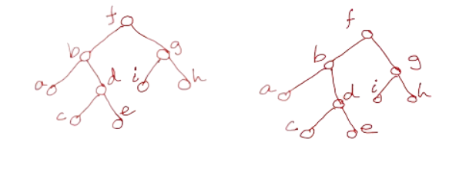
Construct a Binary Tree from Preorder & Postorder
Preoder: f → b → a → d → c → e → g → i → h
Postoder: a → c → e → d → b → i → h → g → f
No unique Tree!!
Need at least one Inorder traversal sequence to construct Unique tree.

Slide 21
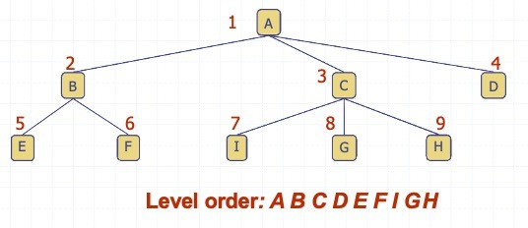
Level Order Traversal
In a level order traversal, every node on a level is visited before going to a lower level

Slide 22
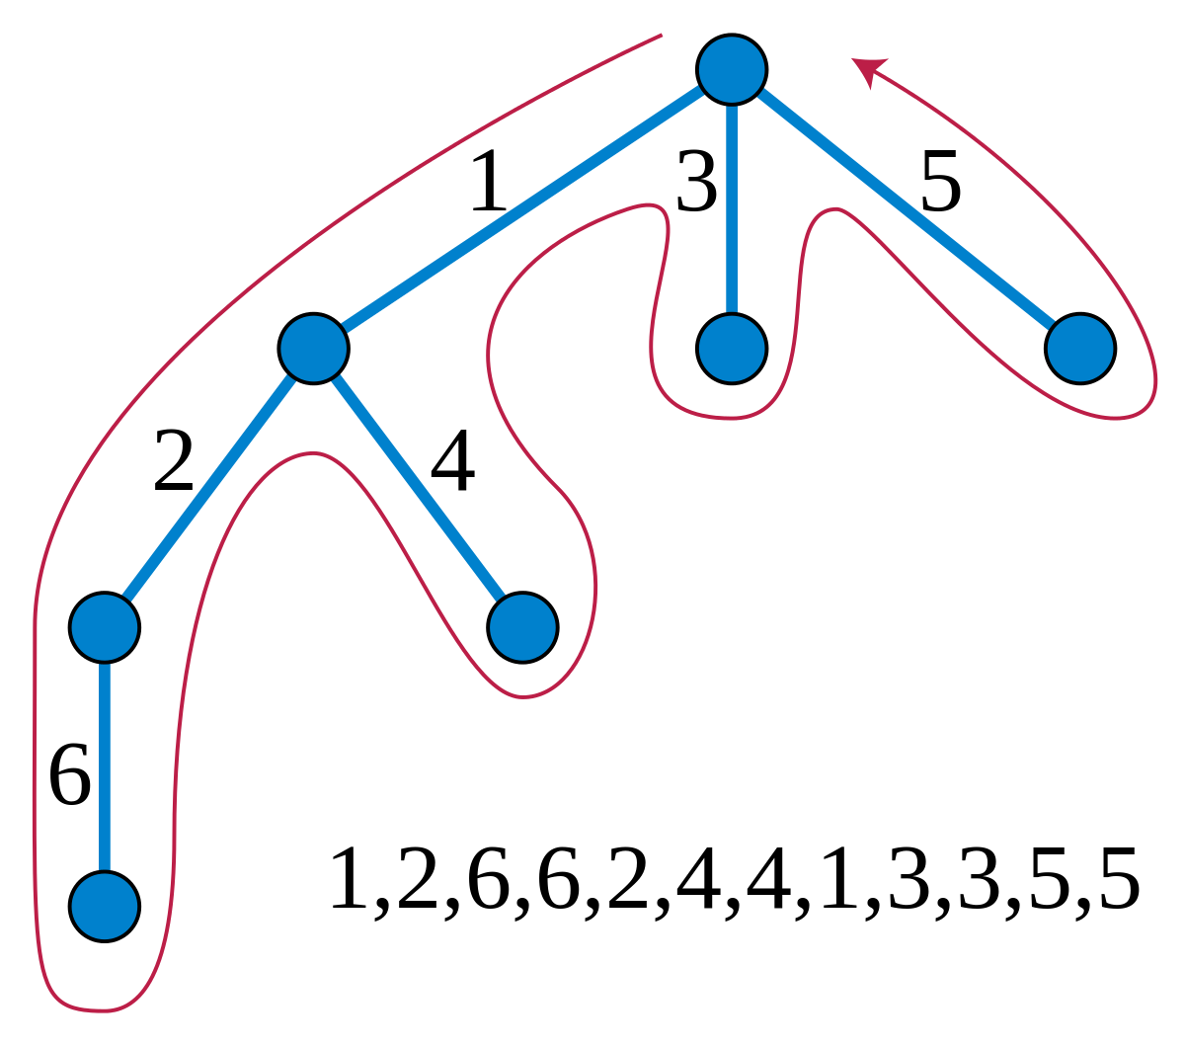
Euler Tour Traversal
Generic traversal of a binary tree
Includes a special cases the preorder, postorder and inorder traversals
Walk around the tree and visit each node three times:
on the left (preorder)
from below (inorder)
on the right (postorder)

Slide 23
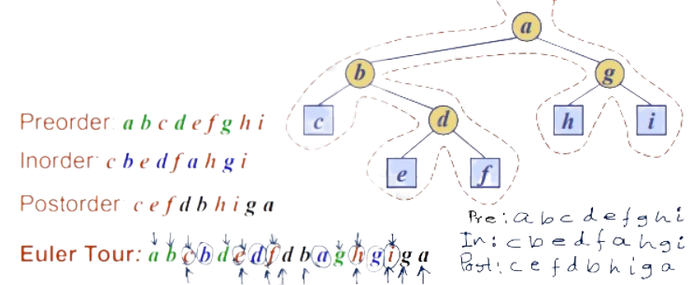
Euler Tour Traversal
Generic traversal of a binary tree
Includes a special cases the preorder, postorder and inorder traversals
Walk around the tree and visit each node three times:
on the left (preorder)
from below (inorder)
on the right (postorder)

Slide 24
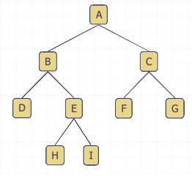
(Proper) Binary Tree
A (proper) binary tree is a tree with the following properties:
Each internal node has two children
The children of a node are an ordered pair
We call the children of an internal node left child and right
child
Alternative recursive definition:
A (proper) binary tree is either
a tree consisting of a single node, or
a tree whose root has an ordered pair of children, each of which is a proper binary tree
Application:
arithmetic expressions
decision processes
searching

Slide 25
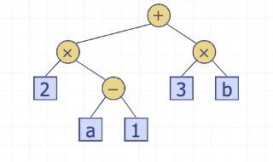
Arithmetic Expression Tree
Binary tree associated with an arithmetic expression
internal nodes: operators
external nodes: operands
Example: arithmetic expression tree for the expression (2 * (a - 1) + (3 * b))

Slide 26
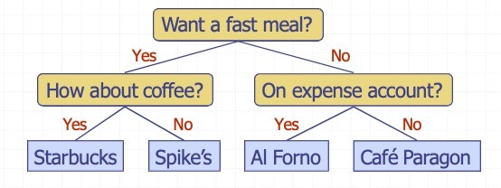
Decision Tree
Binary tree associated with a decision process
internal nodes: questions with yes/no answer
external nodes: decisions
Example: dining decision

Slide 27
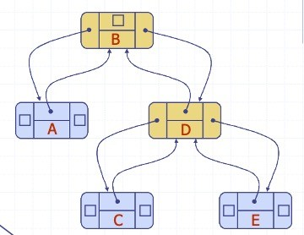
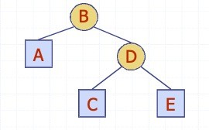
Linked Structure for Binary Trees
A node is represented by an object storing
Element
Parent node
Left child node
Right child node

Slide 28
Codes for Creation of Binary Trees
A binary tree can be created recursively. The program will work as follow:
Read a data in x.
Allocate memory for a new node and store the address in pointer p.
Store the data x in the node p.
Recursively create the left subtree of p and make it the left child of p.
Recursively create the right subtree of p and make it the right child of p.

Slide 29
Codes for Creation of Binary Trees
#include<stdio.h>
typedef struct TreeNode {
struct TreeNode *left;
int data;
struct TreeNode *right;
} TreeNode;

Slide 30
Codes for Creation of Binary Trees
TreeNode * createBinaryTree( ){
TreeNode *p;
int x;
printf("Enter data(-1 for no data): ");
scanf("%d", &x);
if(x == -1) return NULL;
//create current node
p = (TreeNode*) malloc(sizeof(TreeNode));
p->data = x;
//recursively create left and right subtree
printf("Enter left child of %d: \n", x);
p->left = createBinaryTree ( );
printf("Enter right child of %d: \n",x);
p->right = createBinaryTree ();
return p; }

Slide 31
Codes for Creation of Binary Tree Traversal
void preorder(TreeNode *t) {
if(t != NULL) {
printf("\n%d", t->data);
preorder(t->left);
preorder(t->right);
}
}
int main() {
TreeNode *root;
root = createBinaryTree ( );
printf("\nThe preorder traversal of tree is: \n");
preorder(root);
}

Slide 32
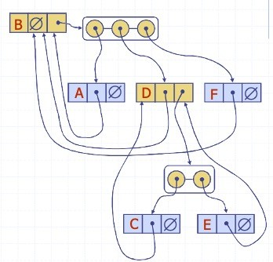
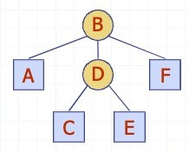
LinkeSd Structure for General Trees
A node is represented by an object storing
Element
Parent node
Children Container: Sequence of children nodes

Slide 33
Thank You

